Slide 1
Microservices
SpringBoot, Rest web services,
various spring database support
29-Mar-2017

Slide 2
Objective
Spring Boot Introduction
Spring Boot Components
Spring Boot Sample Application
WebService Introduction
RESTful Web Service
Sample Rest Service with Spring Boot API
Various Database Support in Spring boot
Sample Rest Service with MySql as DB
Spring Data Introduction
Sample application with SpringData
Notes:
Availability: Rolling out a new version of a microservice requires little downtime
Scalability: Each microservice can be scaled independently using pools, clusters, grids.
Time to Market: No dependency on other services. In monolithic approach, changing a component requires a thorough impact analysis and regression
Resiliency: Components are maintained and deployed independently. Each service can be developed independently and any failure in one app/service doesn’t affect other
Flexible Architecture: Application is broken down into multiple smaller services. Each maintained & deployed independently. Use Technology Stack based on Business function. Each service is independently maintained – Ability to leverage an emerging technical stack where ever required.

Slide 3
Spring Boot Introduction
Spring Boot is an application-bootstrapping framework that helps with the creation of Spring based applications with no necessary XML configuration or code generation. It eases the configuration with its starter pom definitions and bootstrap annotations.
What Spring Boot brings to the table ?
Convention over configuration
Spring Boot has taken away all the XML based configurations and provided Annotations for using the Spring Framework. You can start your application with a very minimum annotation in no time. This would be very helpful to the developers, the team productivity would greatly be impacted positively.
Standardization for Microservices
One of the main objective of Spring Boot is to provide a unified ecosystem of libraries & standards to all the developers (teams) utilizing Microservices methodologies. It also provides-
A common platform and library support
Reduced setup, configuration time in development environment.
Cloud Support
Notes:
Availability: Rolling out a new version of a microservice requires little downtime
Scalability: Each microservice can be scaled independently using pools, clusters, grids.
Time to Market: No dependency on other services. In monolithic approach, changing a component requires a thorough impact analysis and regression
Resiliency: Components are maintained and deployed independently. Each service can be developed independently and any failure in one app/service doesn’t affect other
Flexible Architecture: Application is broken down into multiple smaller services. Each maintained & deployed independently. Use Technology Stack based on Business function. Each service is independently maintained – Ability to leverage an emerging technical stack where ever required.

Slide 4
Spring Boot Introduction
Integrated Server for Development
Spring Boot attaches a Tomcat/Jetty server with the compiled Jar using Maven/Gradle. This helps the developers to expedite the development process by using the integrated server.
Cloud Support
Spring Boot provides cloud support for configuration, tools and clients. It’s also compatible with Cloud Native and works seamlessly with Cloud Foundry, Pivotal etc.
Adapt & Support for 3rd Party Library
Spring Boot has taken a significant step and widen support for 3rd Party Open Source Library like Netflix OSS, No-SQL DB, Distributed Cache etc. You will find a full list in the Spring Boot home page, however the seamless integration using Annotation is very powerful.
Notes:
Availability: Rolling out a new version of a microservice requires little downtime
Scalability: Each microservice can be scaled independently using pools, clusters, grids.
Time to Market: No dependency on other services. In monolithic approach, changing a component requires a thorough impact analysis and regression
Resiliency: Components are maintained and deployed independently. Each service can be developed independently and any failure in one app/service doesn’t affect other
Flexible Architecture: Application is broken down into multiple smaller services. Each maintained & deployed independently. Use Technology Stack based on Business function. Each service is independently maintained – Ability to leverage an emerging technical stack where ever required.

Slide 5
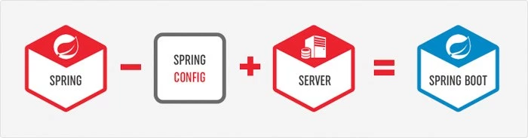
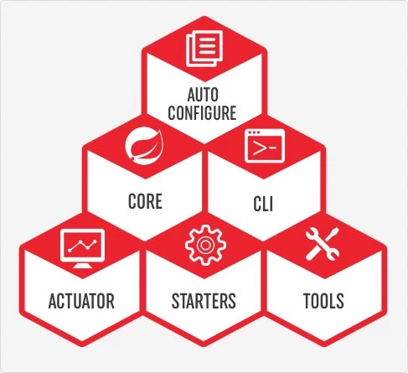
Spring Boot Introduction
What is Spring Boot ?
In one sentence, Spring Boot is equal to ( Spring Framework – XML Configuration ) + Integrated Server.
Spring Boot Components
Notes:
Availability: Rolling out a new version of a microservice requires little downtime
Scalability: Each microservice can be scaled independently using pools, clusters, grids.
Time to Market: No dependency on other services. In monolithic approach, changing a component requires a thorough impact analysis and regression
Resiliency: Components are maintained and deployed independently. Each service can be developed independently and any failure in one app/service doesn’t affect other
Flexible Architecture: Application is broken down into multiple smaller services. Each maintained & deployed independently. Use Technology Stack based on Business function. Each service is independently maintained – Ability to leverage an emerging technical stack where ever required.

Slide 6
Spring Boot Introduction
Spring Boot Auto Configure
Module to auto configure a wide range of Spring projects. It will detect availability of certain frameworks (Spring Batch, Spring Data JPA, Hibernate, JDBC). When detected it will try to auto configure that framework with some sensible defaults, which in general can be overridden by configuration in an application.properties/yml file.
Spring Boot Core
The base for other modules, but it also provides some functionality that can be used on its own, eg. using command line arguments and YAML files as Spring Environment property sources and automatically binding environment properties to Spring bean properties (with validation).
Spring Boot CLI
  A command line interface, based on ruby, to start/stop spring boot created applications.
Spring Boot Actuator
This project, when added, will enable certain enterprise features (Security, Metrics, Default Error pages) to your application. As the auto configure module it uses auto detection to detect certain frameworks/features of your application. For an example, you can see all the REST Services defined in a web application using Actuator.
Notes:
Availability: Rolling out a new version of a microservice requires little downtime
Scalability: Each microservice can be scaled independently using pools, clusters, grids.
Time to Market: No dependency on other services. In monolithic approach, changing a component requires a thorough impact analysis and regression
Resiliency: Components are maintained and deployed independently. Each service can be developed independently and any failure in one app/service doesn’t affect other
Flexible Architecture: Application is broken down into multiple smaller services. Each maintained & deployed independently. Use Technology Stack based on Business function. Each service is independently maintained – Ability to leverage an emerging technical stack where ever required.

Slide 7
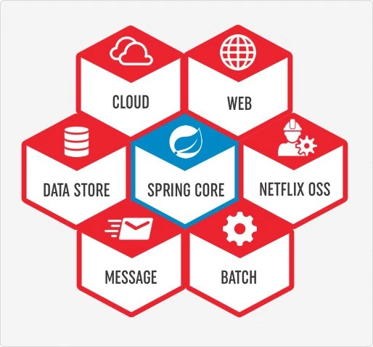
Spring Boot Introduction
Spring Boot Starters
Different quick start projects to include as a dependency in your maven or gradle build file. It will have the needed dependencies for that type of application. Currently there are many starter projects and many more are expected to be added. At a high-level there are so far 6 types of starters packages available.
Spring Boot Tools
The Maven and Gradle build tool as well as the custom Spring Boot Loader (used in the single executable jar/war) is included in this project.
Notes:
Availability: Rolling out a new version of a microservice requires little downtime
Scalability: Each microservice can be scaled independently using pools, clusters, grids.
Time to Market: No dependency on other services. In monolithic approach, changing a component requires a thorough impact analysis and regression
Resiliency: Components are maintained and deployed independently. Each service can be developed independently and any failure in one app/service doesn’t affect other
Flexible Architecture: Application is broken down into multiple smaller services. Each maintained & deployed independently. Use Technology Stack based on Business function. Each service is independently maintained – Ability to leverage an emerging technical stack where ever required.

Slide 8
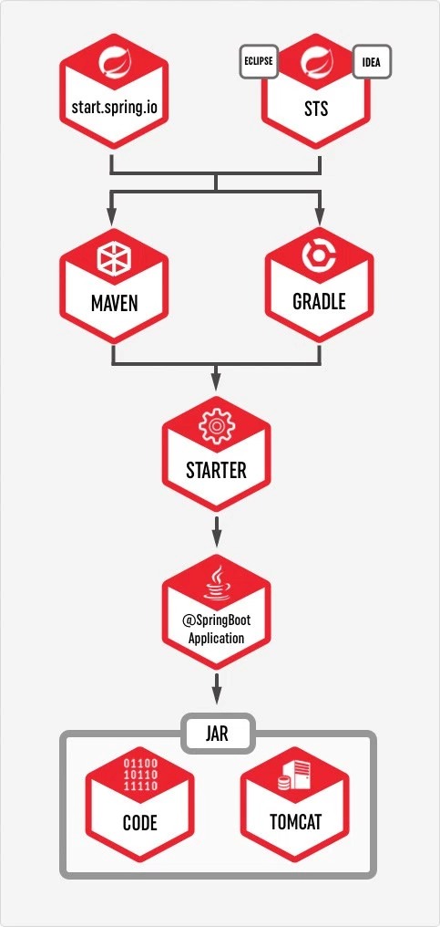
Spring Boot Introduction
How to use Spring Boot
You can use spring initialize to create the initial setup. Support available in IDEA or Eclipse to choose all the Spring Boot Starters
You need to also choose whether to use Maven or Gradle as the build tool.
If you are using start.spring.io, you need to then download the zip and configure your workspace. Otherwise using your preferred IDE will automatically create the required file in the workspace.
Add your code as required
You can either use mvn clean package or use IDEA or Eclipse to build and create the jar file.
By default the JAR would include integrated Tomcat server, so just by executing the JAR you should be able to use your program.

Slide 9
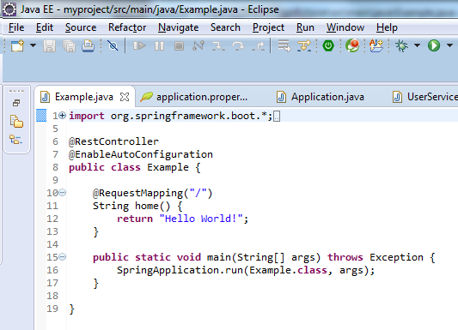
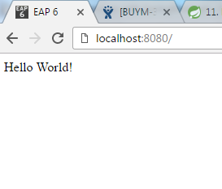
Spring Boot Sample Application
Example SpringBoot application – Must contain a pom.xml and a main class
1. Dependency Management [pom.xml]
<project xmlns="http://maven.apache.org/POM/4.0.0" xmlns:xsi="http://www.w3.org/2001/XMLSchema-instance" xsi:schemaLocation="http://maven.apache.org/POM/4.0.0 http://maven.apache.org/xsd/maven-4.0.0.xsd">
<modelVersion>4.0.0</modelVersion>
<groupId>com.example</groupId>
<artifactId>myproject</artifactId>
<version>0.0.1-SNAPSHOT</version>
<name>SpringBootExample</name>
<parent>
<groupId>org.springframework.boot</groupId>
<artifactId>spring-boot-starter-parent</artifactId>
<version>1.5.2.RELEASE</version>
</parent>
<dependencies>
<dependency>
<groupId>org.springframework.boot</groupId>
<artifactId>spring-boot-starter-web</artifactId>
</dependency>
</dependencies>
<build>
<plugins>
<plugin>
<groupId>org.springframework.boot</groupId>
<artifactId>spring-boot-maven-plugin</artifactId>
</plugin>
</plugins>
</build>
</project>
Sample Application O/P

Slide 10
Web-services
• Web Services are software component which are available over internet
• WS are language neutral and platform neutral because of message is of type JSON / XML and transport is http (mostly)
• WS provides loose coupling between software components
• Web services provides re-usable software components
• Unlike client/server model, web-services does not participate in GUI model
• As described by the World Wide Web Consortium (W3C), web services provide a standard means of interoperating between software applications running on a variety of platforms and frameworks.

Slide 11
RESTful Web Services
REST stands for Representational State Transfer. It is an architectural style which can be used to design web services and allows user to access web-service over http protocol, that can be consumed from a variety of clients. The core idea is that, rather than using complex mechanisms such as CORBA, RPC or SOAP to connect between machines, simple HTTP is used to make calls among them.
In Rest based design, resources are being manipulated using a common set of verbs.
To Create a resource : HTTP POST should be used
To Retrieve a resource : HTTP GET should be used
To Update a resource : HTTP PUT should be used
To Delete a resource : HTTP DELETE should be used
That means, you as a REST service developer or Client, should comply to above criteria, in order to be REST complained.
Often Rest based Web services return JSON or XML as response, although it is not limited to these types only. Clients can specify (using HTTP Accept header) the resource type they are interested in, and server may return the resource , specifying Content-Type of the resource it is serving.

Slide 12
SpringBoot REST Api Example
Example for Restful services using SpringBoot application
1. Dependency Management [pom.xml]
<parent>
<groupId>org.springframework.boot</groupId>
<artifactId>spring-boot-starter-parent</artifactId>
<version>1.2.3.RELEASE</version>
</parent>
<dependencies>
<dependency>
<groupId>org.springframework.boot</groupId>
<artifactId>spring-boot-starter-web</artifactId>
</dependency>
<dependency>
<groupId>org.springframework.boot</groupId>
<artifactId>spring-boot-starter-data-mongodb</artifactId>
</dependency>
<dependency>
<groupId>org.springframework.boot</groupId>
<artifactId>spring-boot-starter-test</artifactId>
</dependency>
</dependencies>
3. REST Controller
Following is one possible Rest based controller, implementing REST API.
GET request to /api/user/ returns a list of users
GET request to /api/user/1 returns the user with ID 1
POST request to /api/user/ with a user object as JSON creates a new user
PUT request to /api/user/3 with a user object as JSON updates the user with ID 3
DELETE request to /api/user/4 deletes the user with ID 4
DELETE request to /api/user/ deletes all the users

Slide 13
SpringBoot REST Api Example
2. Main class [Application]
The @SpringBootApplication annotation is the starting point of Spring Boot application. We will initialize the application by calling the following line from our main method.
@SpringBootApplication
public class Application {
public static void main(String[] args) {
SpringApplication.run(Application.class, args);
}
}
3. Book object Model
To define the properties of the Book object and its corresponding getters/setters.
4. Book Repository
The interface of the Book Repository
.

Slide 14
RESTful Web Services
5. Controller
Following is one possible Rest based controller, implementing REST API
GET request to /book/getAllBooks returns a list of books
GET request to /book/getBook/1 returns the book with ID 1
POST request to /book/createBook/ with a book object as JSON creates a new book
PUT request to /book/editBook/3 with a book object as JSON updates the book with ID 3
DELETE request to /book/deleteBook/4 deletes the book with ID 4
The annotations used commonly in a controller:
@RestController : we are using Spring 4′s new @RestController annotation. This annotation eliminates the need of annotating each method with @ResponseBody. Under the hood, @RestController is itself annotated with @ResponseBody, and can be considered as combination of @Controller and @ResponseBody.
@RequestBody : If a method parameter is annotated with @RequestBody, Spring will bind the incoming HTTP request body(for the URL mentioned in @RequestMapping for that method) to that parameter. While doing that, Spring will [behind the scenes] use HTTP Message converters to convert the HTTP request body into domain object [deserialize request body to domain object], based on ACCEPT or Content-Type header present in request.

Slide 15
@ResponseBody : If a method is annotated with @ResponseBody, Spring will bind the return value to outgoing HTTP response body. While doing that, Spring will [behind the scenes] use HTTP Message converters to convert the return value to HTTP response body [serialize the object to response body], based on Content-Type present in request HTTP header. As already mentioned, in Spring 4, you may stop using this annotation.
ResponseEntity is a real deal. It represents the entire HTTP response. Good thing about it is that you can control anything that goes into it. You can specify status code, headers, and body. It comes with several constructors to carry the information you want to sent in HTTP Response.
@PathVariable This annotation indicates that a method parameter should be bound to a URI template variable [the one in '{}'].
Basically, @RestController , @RequestBody, ResponseEntity & @PathVariable are all you need to know to implement a REST API in Spring. Additionally, spring provides several support classes to help you implement something customized.

Slide 16
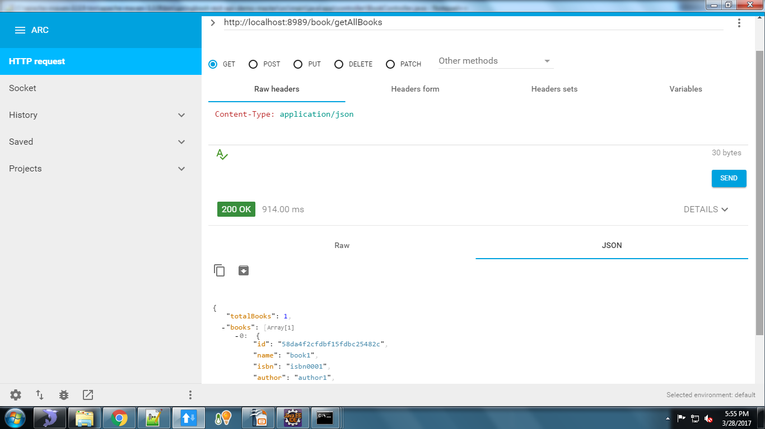
NoSql(Mongo) Get Service O/P

Slide 17
Different Database support
Working with SQL databases
The Spring Framework provides extensive support for working with SQL databases. From direct JDBC access using JdbcTemplate to complete ‘object relational mapping’ technologies such as Hibernate. Spring Data provides an additional level of functionality, creating Repository implementations directly from interfaces and using conventions to generate queries from your method names.
Configure a DataSource
Spring Boot can auto-configure embedded H2, HSQL and Derby databases. You don’t need to provide any connection URLs, simply include a build dependency to the embedded database that you want to use.
POM dependencies would be:
<dependency>
<groupId>org.springframework.boot</groupId>
<artifactId>spring-boot-starter-data-jpa</artifactId>
</dependency>
<dependency>
<groupId>org.hsqldb</groupId>
<artifactId>hsqldb</artifactId>
<scope>runtime</scope>
</dependency>

Slide 18
Different Database support
Connection to a JNDI DataSource
If you are deploying your Spring Boot application to an Application Server you might want to configure and manage your DataSource using your Application Servers built-in features and access it using JNDI.
The spring.datasource.jndi-name property can be used as an alternative to the spring.datasource.url, spring.datasource.username and spring.datasource.password properties to access the DataSource from a specific JNDI location. For example, the following section in application.properties shows how you can access a JBoss AS defined DataSource:
spring.datasource.jndi-name=java:jboss/datasources/customers
Using JdbcTemplate
Spring’s JdbcTemplate and NamedParameterJdbcTemplate classes are auto-configured and you can @Autowire them directly into your own beans

Slide 19
Sample Rest Service with MySql as DB
Sample Rest Service with MySql as DB
The following properties are need to configure MySQL with Spring Boot. You can see these are pretty standard Java data source properties.
spring.datasource.url= jdbc:mysql://localhost:3306/check
spring.datasource.username=root
spring.datasource.password=
Dependencies used:
springbootstarterjdbc – This spring boot provided starter is responsible for support to connect and use JDBC databases, and other JDBC related services like connection pools etc.
springbootstarterdata-jpa – This is again spring boot provided JPA starter that provides the dependent libraries related to Java Persistence API, the JPA provider like Hibernate.
mysql-connector-java – MySQL java driver
We need >mysql-connector-java only at runtime so its scope can be set to runtime. This is because DataSource object provides abstraction to underlying datasource so we don’t really need the database driver at compile time

Slide 20
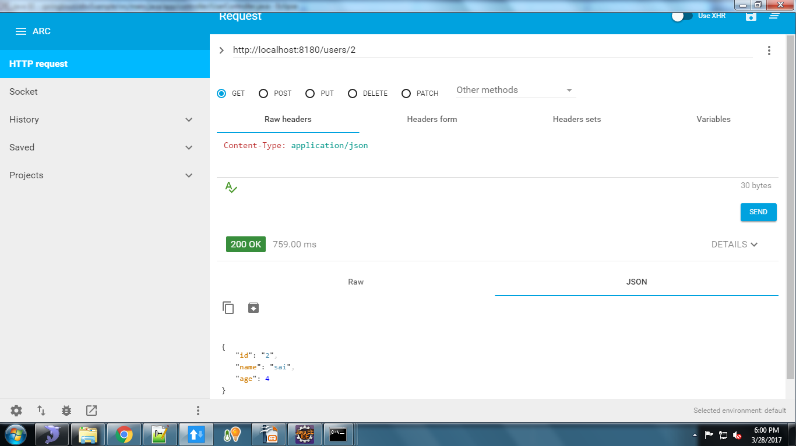
MySql Get Service O/P

Slide 21
Spring Data Introduction
Spring Data is a high level project developed by Spring community aimed at simplifying the data access operations for the applications. There are several sub-projects maintained for the individual storesÂ to have its own implementation of repositories.
If you are using Spring Data in your project, you are not going to write most of the low level data access operations like writing SQL query, DAO classes, Â etc. Spring Data will generate everything dynamically at run-time by creating the proxy instances of your abstract repositories and perform the required operations. What you write is the abstract interfaces that define the required operations.
The commonly used sub project is Spring Data JPA. Other than that Spring Data has the following sub-projects:
Spring Data Commons, Spring Data MongoDB, Spring Data Redis, Spring Data Solr, Spring Data Gemfire, Spring Data REST, Spring Data Neo4j
Spring Data JPA, it is part of the Spring Data family, aims to provide the JPA based repositories that aims to simplify the implementation of data access layer using JPA.
spring-boot-starter-parent loads all the default configurations required for the basic spring boot applications.
spring-boot-starter-data-jpa dependency will download the files required for spring data jpa.
spring-boot-starter-webis required because it is web based application to expose the REST endpoints.
The above configurations sufficient to get started developing our simple REST APIs application using Spring Data JPA.

Slide 22
Spring Data Repositories
When you are working with spring data technologies, it is important to understand the repositories concept. Spring data provides the abstract repositories, that are implemented at run-time by the spring container and perform the CRUD operations. As a developer we have to just provide the abstract methods in the interface. This reduces the amount of boilerplate code required to write data access layers.
The following are the three base interfaces defined in the spring data commons project.
Repository
It is the central interface in the spring data repository abstraction. This is a marker interface. If you are extending this interface, you have to declare your own methods and the implementations will be provided by the spring run-time. For this interface also we have to pass two parameters:type of the entity and type of the entity’s id field.Â This is the super interface for CrudRepository.
CrudRepository
CrudRepository provides methods for the CRUD operations. This interface extends the Repository interface. When you define CrudRepository, you have to pass the two parameters: type of the entity and type of the entity’s id field. This interface has the following methods: T findOne(ID primaryKey), Iterable findAll(), Long count(), void delete(T entity), boolean exists(ID primaryKey)
If you are extending the CrudRepository, there is no need for implementing your own methods. Just extend this interface and leave it as blank. Required implementations are provide at run time.

Slide 23
JPA Vs CRUD Repository
Both, JpaRepository and CrudRepository are base interfaces in Spring Data. Application developer has to choose any of the base interfaces for your own repository. It has two purposes,
One is to allow spring data to create proxy instance for your repository interface.
Second one is to inherit the maximum default functionality from the base interfaces without declaring your own methods.
When we look at both of the interfaces, the clear differences are:
CrudRepository is part of Spring Data Commons project and declared under the package org.springframework.data.repository. Where as JpaRepository is part of store specific implementation and declared under the package org.springframework.data.jpa.repository.
CrudeRepository extnds from Repository interface. Where as JpaRepository extends from PagingAndSortingRepository which inturen extends from the CrudeRepository.
JpaRepository returns List type of entities and CrudRepository returns Iterable type of entities.
It is general recommendation that not to use the store specific base interfaces as they expose the underlying persistence technology and tighten the coupling between them and the repository. It is always good idea to choose any of the generic base interfaces like CrudRepository or PagingAndSortungRepository.

Slide 24
Thank You !!

